Slide 1
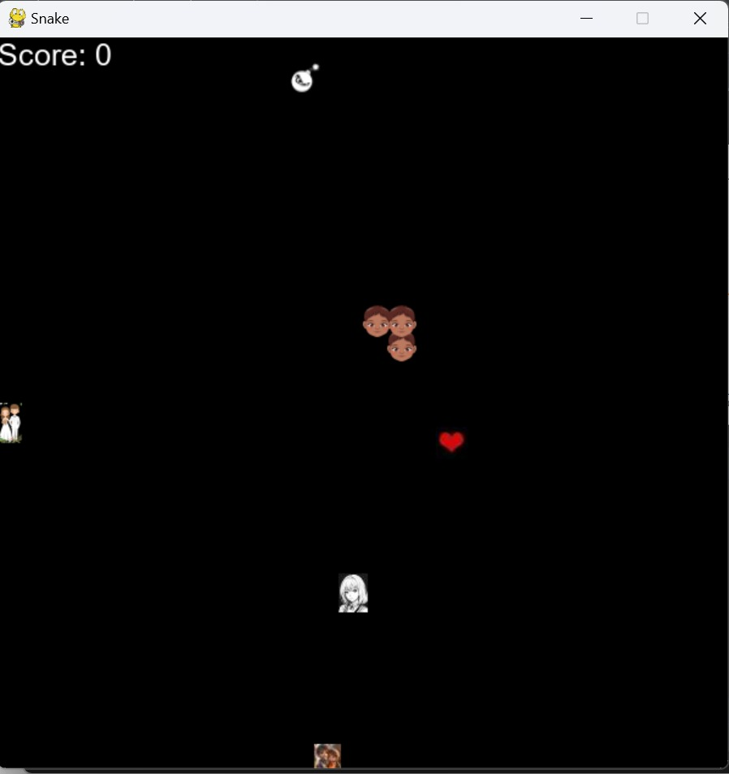
FLAMES – A Chasing Game
Inspired by snake game
By:
Parul Bhutani Wadhwa
Snehal Kathiriya
Amandeep Kaur
Kiranpal Sidhu
Vatsal Shah
Arvind Pal Singh

Slide 2
Introduction to FLAMES Game
AI-driven game called "FLAMES", Friend, Love, Affair, Marriage, Enemy & Siblings
Inspired by the classic Snake game.
Create an interactive and engaging environment where an AI agent can learn and adapt its strategy to play the game efficiently.
Implement reinforcement learning and deep Q-learning,
Demonstrate the capabilities of AI in game strategy and decision-making.

Slide 3
HISTORY & BACKGROUND
The concept of RL is rooted in
Behavioral psychology
Arthur Samuel(1959) proposed and Implement a learning method
Formalized in the 1980s with the convergence of studies in psychology, neuroscience, and computer science.
In 1989, Ian Witten and Chris Watkin’s develop Q-learning

Slide 4
Basics of Reinforcement learning
Reinforcement learning (RL) is a type of machine learning paradigm where an agent learns how to make decisions by interacting with an environment. The agent takes actions, and in return, it receives feedback in the form of rewards or punishments.
Key components: Agent, Environment, State, Action, Reward.

Slide 5
Components of Reinforcement Learning
Agent
Environment
State
Action
Reward
The learner or decision maker
The external system with which the agent interacts
The current situation or configuration
The decision or move made by the agent.
The feedback from the environment, indicating the success or failure of an action.

Slide 6
Applications
Energy Management
Manufacturing
Retail
Finance
Healthcare
In smart grids, RL aids in optimizing energy production, distribution, and consumption, contributing to more efficient and sustainable energy use.
RL improves operational efficiency by optimizing production lines and maintenance schedules.
Used in recommendation systems, RL helps in personalizing shopping experiences and managing stock levels..
Beyond trading, RL is used for credit scoring, fraud detection, and managing financial risks.
RL is used to personalize treatment plans, manage patient care, and optimize resource allocation in hospitals.

Slide 7
A Real-life Use Case
Companies like Gatik are pioneering the use of autonomous vehicles (AVs) in the logistics sector, focusing on middle and last-mile deliveries. Their innovations are transforming the supply chain, enhancing efficiency, and redefining customer service in the retail and logistics industries.
Gatik: Revolutionizing Middle Mile Deliveries
Gatik's primary focus is on middle mile deliveries, a crucial segment in the supply chain that involves transporting goods from distribution centers to retail stores. This segment has traditionally been labor-intensive and costly, but Gatik's autonomous trucks are changing the landscape. By deploying AVs on these repetitive and predictable routes, Gatik is addressing several challenges:
Efficiency
Cost Reduction
Safety and Reliability

Slide 8
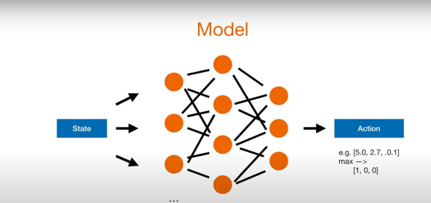
Q - Learning
Q-learning is a model-free reinforcement learning algorithm used to find the optimal action-selection policy for a given finite Markov decision process (MDP). It enables an agent to learn from its environment by iteratively updating its action-value function. The goal of Q-learning is to learn a policy that maximizes the total expected reward over time.

Slide 9
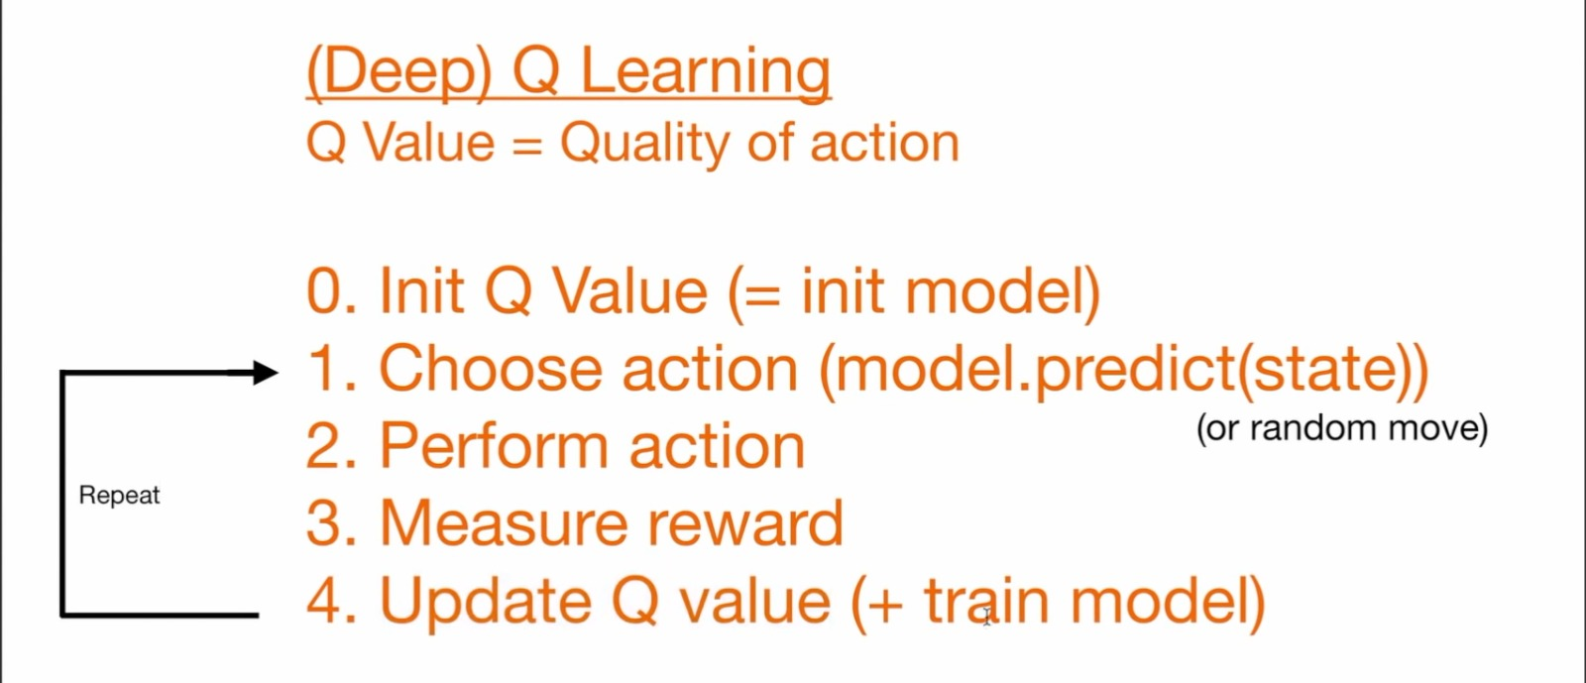
(Deep) Q-Learning

Slide 10
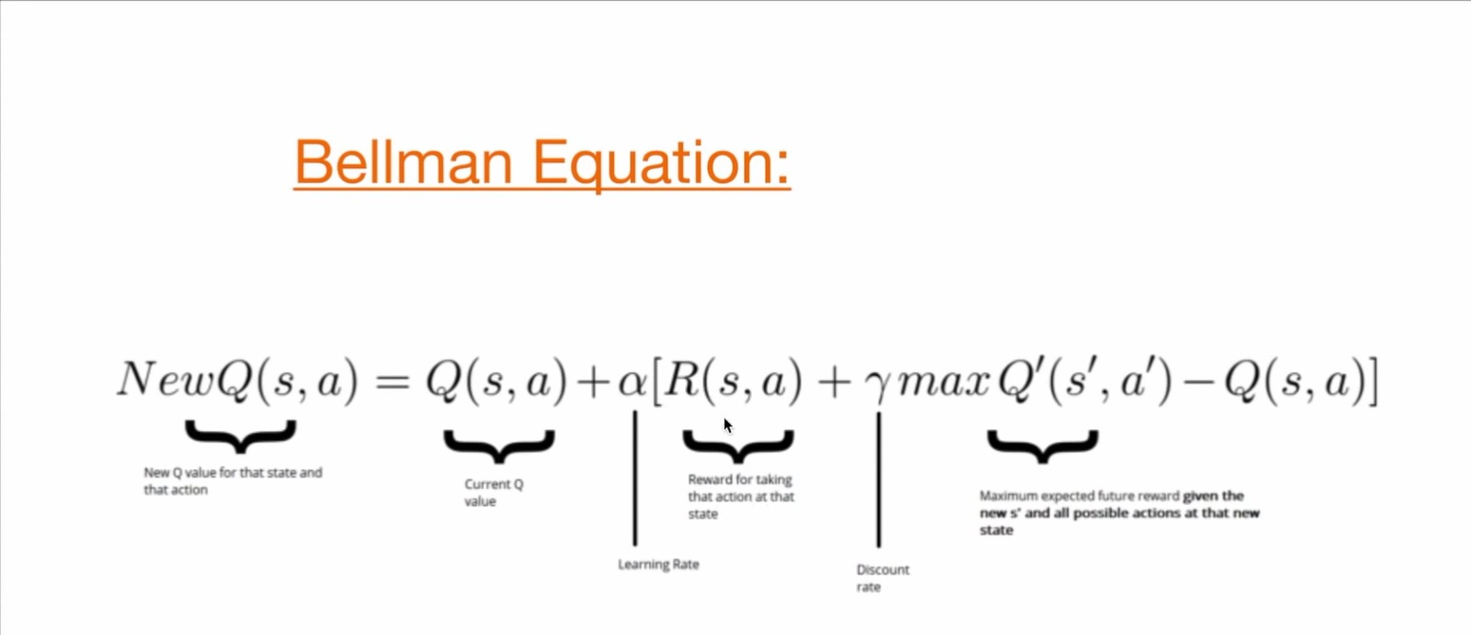
Equation

Slide 11
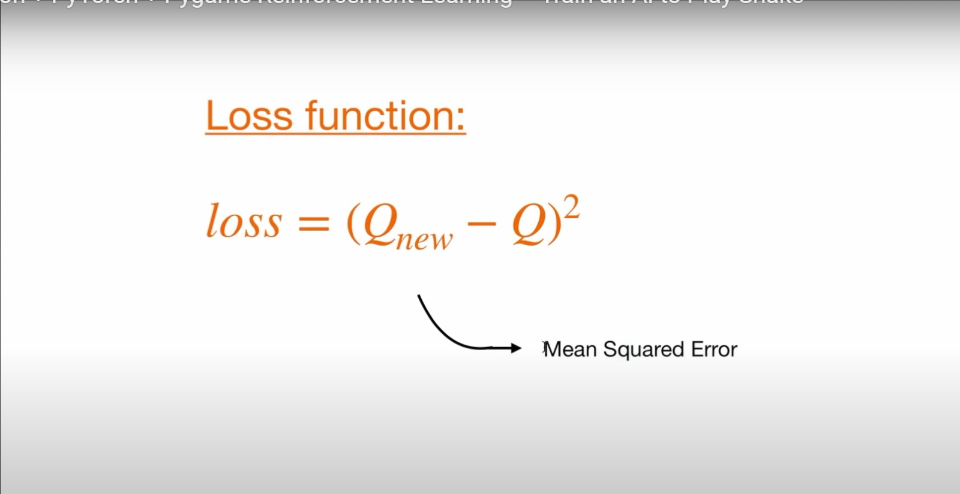
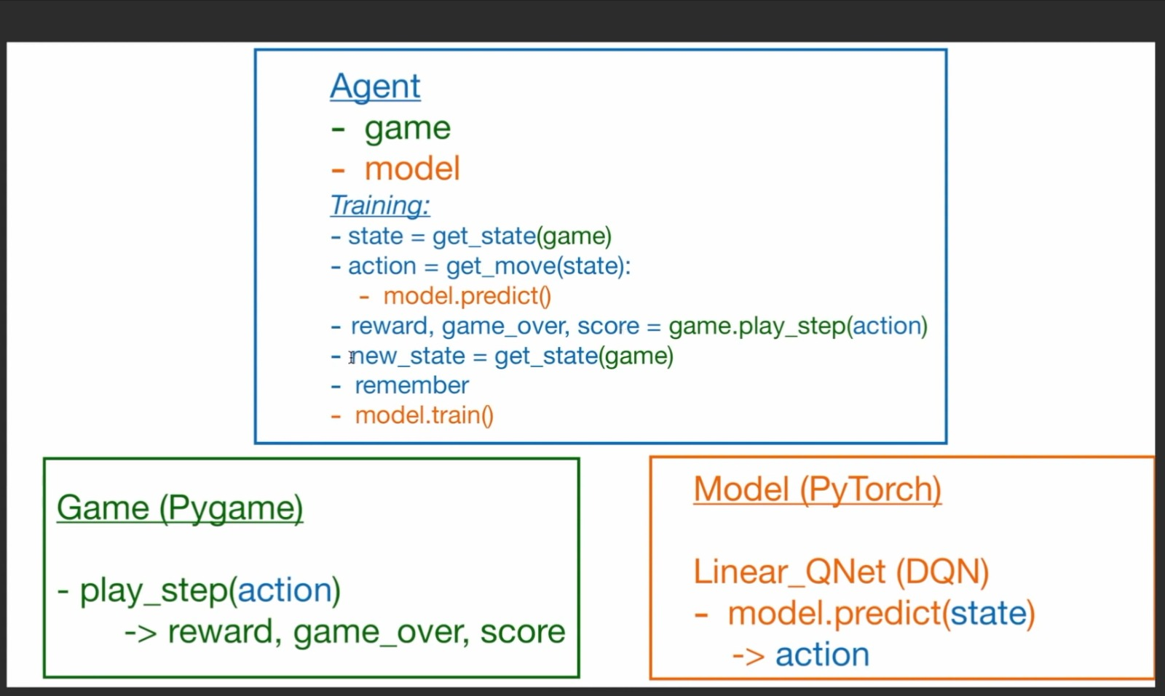
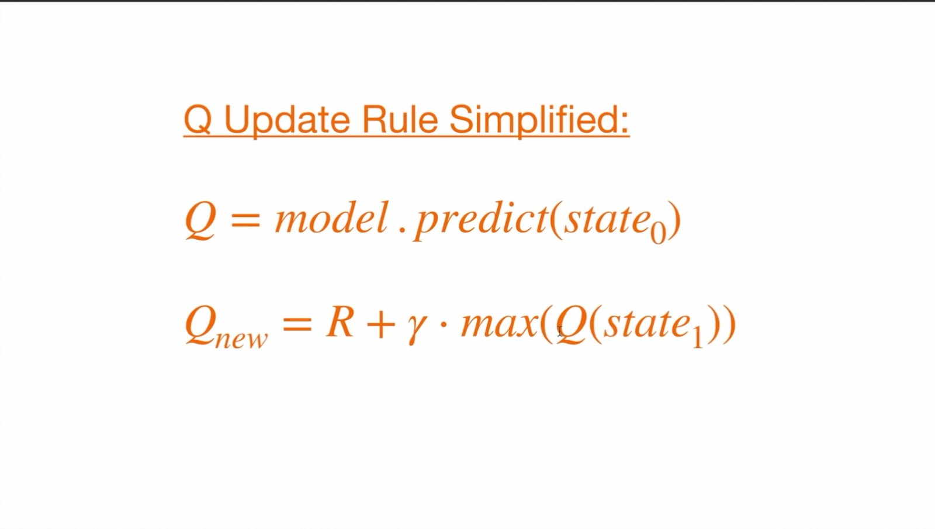
Functions

Slide 12
FLAMES – A chasing Game
Environment
The grid in which the Flames game is played, including obstacles and objects.
Agent
The RL algorithm, controlling the Flames movements.
States
The various positions of the Flames objects on the grid.
Actions
Moving the Flames in different directions (up, down, left, right).
Rewards
Positive for chasing object (increasing the length of character), negative for hitting walls, itself or Enemy object.

Slide 13
Key Insights
The RL agent in the Flames game starts without prior knowledge and improves through continuous gameplay.
The learning process exemplifies the essence of reinforcement learning, where the agent adapts its strategy based on the feedback from its actions.
This Flames game implementation provides a tangible example of how reinforcement learning can be applied to develop intelligent agents capable of learning and adapting in dynamic environments.

Slide 14
References
DriveU.auto. (n.d.). Autonomous vehicles: Path to ROI & profitable use cases. Retrieved from https://driveu.auto/blog/autonomous-vehicles-path-to-roi-profitable-use-cases/
Santa Clara University. (n.d.). 9 real-life examples of reinforcement learning. Retrieved from https://onlinedegrees.scu.edu/media/blog/9-examples-of-reinforcement-learning
Analytics Steps. (n.d.). Real world applications of reinforcement learning. Retrieved from https://www.analyticssteps.com/blogs/real-world-applications-reinforcement-learning
Loeber, P. (n.d.). Snake AI PyTorch. GitHub. Retrieved from https://github.com/patrickloeber/snake-ai-pytorch
Loeber, P. [Patrick Loeber]. (n.d.). Teach AI to play Snake! Reinforcement Learning with PyTorch and Pygame [Video file]. Retrieved from https://www.youtube.com/watch?v=L8ypSXwyBds

Slide 15

ANY QUESTIONS?

